Slide 1
主讲人：杨中科 .NET /.NET Core 教程 第三部分 EFCore-19 自引用的组织结构树

Slide 2
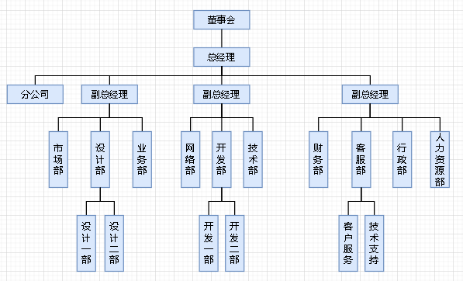

Slide 3
class OrgUnit
{
public long Id { get; set; }
public string Name { get; set; }
public OrgUnit Parent { get; set; }
public List<OrgUnit> Children { get; set; } = new List<OrgUnit>();
}

Slide 4
builder.ToTable("T_OrgUnits");
builder.Property(o => o.Name).IsRequired().IsUnicode().HasMaxLength(100);
builder.HasOne<OrgUnit>(u => u.Parent).WithMany(p => p.Children);

Slide 5
测试
1、测试数据插入
2、测试递归缩进打印
PrintChildren(int indentLevel, TestDbContext ctx,OrgUnit parent)
Notes:
static async Task Main(string[] args)
{
using (TestDbContext ctx = new TestDbContext())
{
OrgUnit ouRoot = ctx.OrgUnits.Single(o=>o.Parent==null);
Console.WriteLine(ouRoot.Name);
PrintChildren(0, ctx, ouRoot);
}
}
static void PrintChildren(int indentLevel, TestDbContext ctx,OrgUnit parent)
{
//获取以parent为父节点的组织单元
var children = ctx.OrgUnits.Include(o => o.Children).Where(o=>o.Parent==parent);
indentLevel++;//缩进级别
foreach (var ou in children)
{
Console.Write(new string('+',indentLevel));//输出缩进
Console.WriteLine(ou.Name);
PrintChildren(indentLevel, ctx, ou);
}
}

Slide 6
谢谢
我是杨中科
一名快乐的程序员

